Slide 1

RUL Prediction on C-MAPSS
Predictive maintenance and Remaining Useful Life (RUL) estimation using advanced machine learning architectures on NASA's benchmark datasets.
This presentation explores the end-to-end pipeline for prognostic modeling, covering dataset exploration, rigorous preprocessing, and comparative modeling strategies for multivariate time-series data.

Slide 2
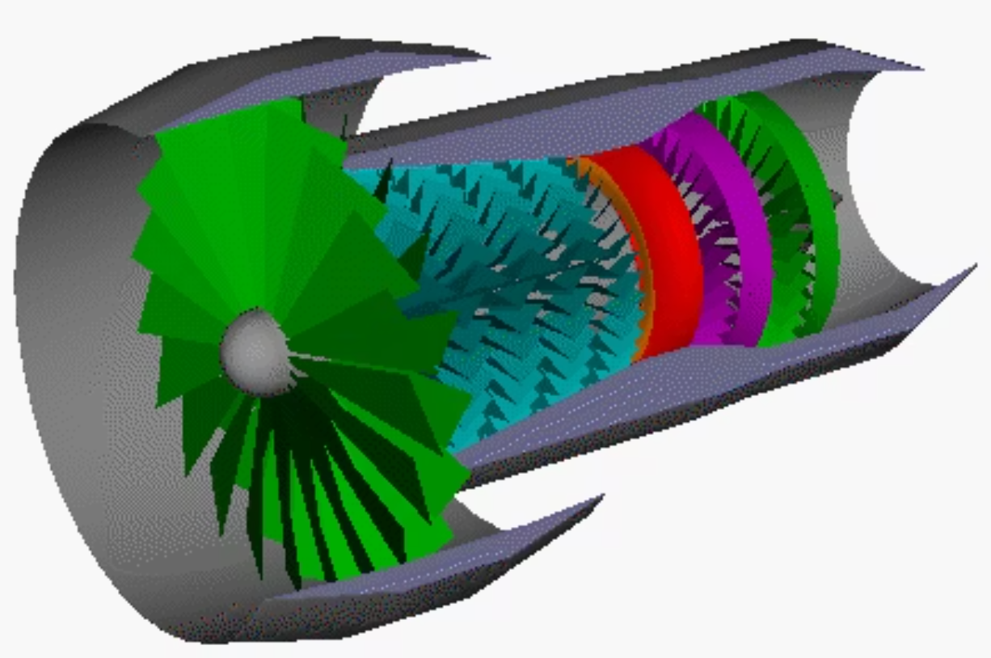
OVERVIEW
C-MAPSS Dataset Description
The Commercial Modular Aero-Propulsion System Simulation (C-MAPSS) datasets represent a standard benchmark for prognostic health management (PHM). We focus on scenarios FD001 through FD003.
FD001: Single condition, single fault mode.
FD002: Six operating conditions, single fault mode.
FD003: Single condition, two fault modes.
Preprocessing Rigor
Noise Reduction
Normalization via Z-score is learned strictly on training data to prevent data leakage.
Light temporal smoothing is applied to highlight the underlying degradation trends over raw sensor noise.

Slide 3
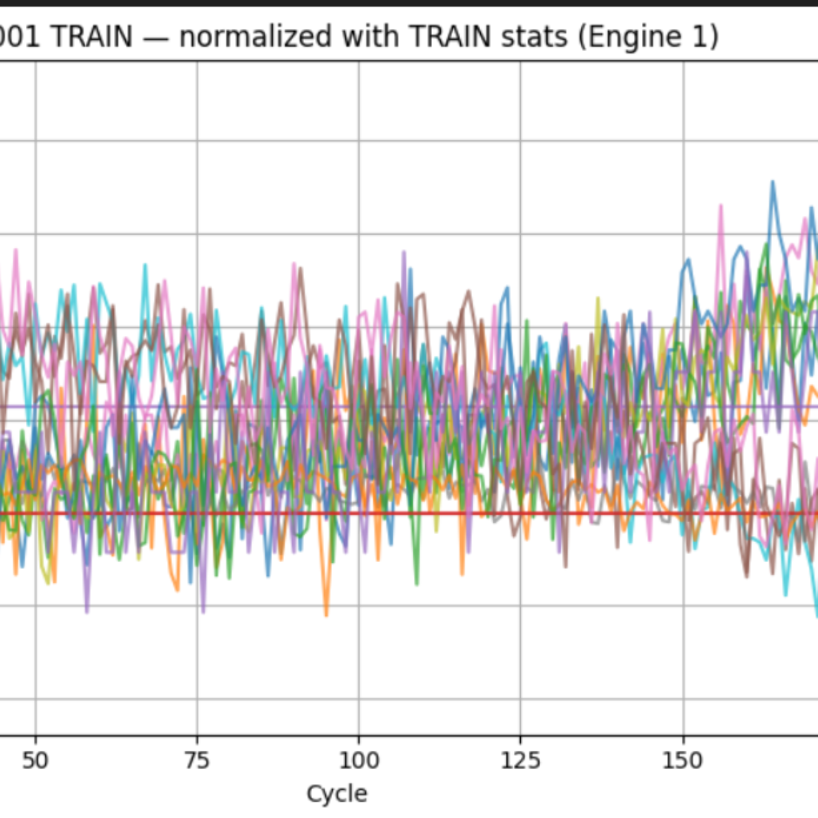
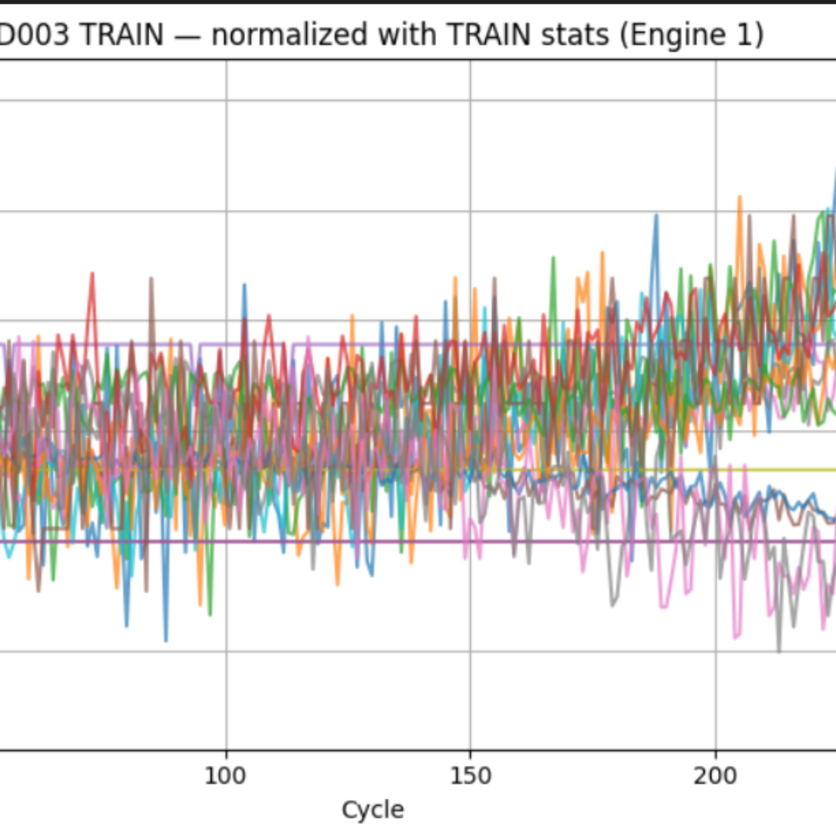
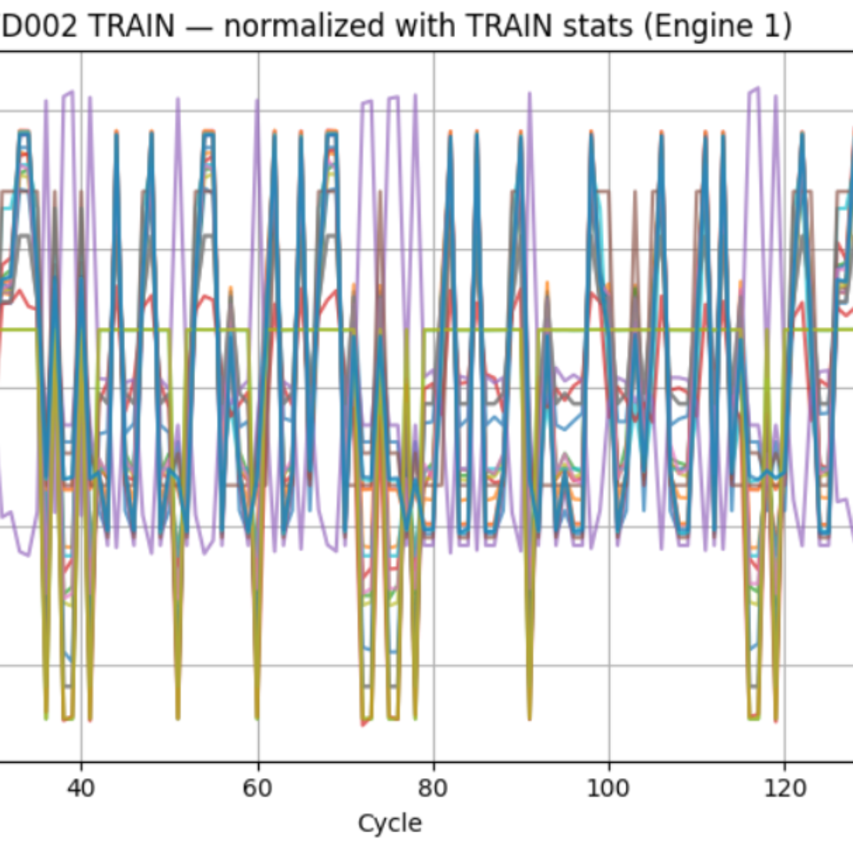

Data Preprocessing: Scaling & Normalization
Sensors exhibit vastly different physical units and ranges. Z-score normalization removes scale effects while preserving relative temporal dynamics, allowing degradation patterns to be compared across sensors and scenarios.
Critical: All means and standard deviations are computed on the training set only to ensure zero data leakage and valid generalization to unseen test engines.

Slide 4








Noise Reduction Strategy
Raw Signals
Preprocess
EWMA Smoothing
Trend Extraction
FD001–FD003
Temporal Smoothing
Preserve Structure
Utilizing Moving Averages or EWMA to suppress transient spikes that do not reflect asset health.
Avoiding overly aggressive filtering to ensure the model captures the specific "elbow" point of failure.

Slide 5



Sensor Selection
To optimize model performance and reduce training complexity, we filter the 21 available sensor channels down to an informative subset.
Eliminate Constants
Correlation Analysis
Relevance Scoring
Sensors that provide zero variance or non-degrading signals are removed immediately.
Redundant sensors with near-perfect collinearity are reduced to single representatives.
Final subsets are determined by model-based feature importance, tailored for each FD scenario.

Slide 6
Tested Algorithms
We evaluated three distinct architectural approaches to assess the trade-off between static tabular methods and deep temporal sequence modeling.
Random Forest
Gradient Boosting
LSTM
Robust, non-linear ensemble used for its stability and ability to handle high-dimensional feature spaces.
Serving as a strong tabular baseline, capable of capturing complex interactions between sensor states.
Long Short-Term Memory networks for sequence-based modeling to capture long-term dependencies in engine wear.

Slide 7
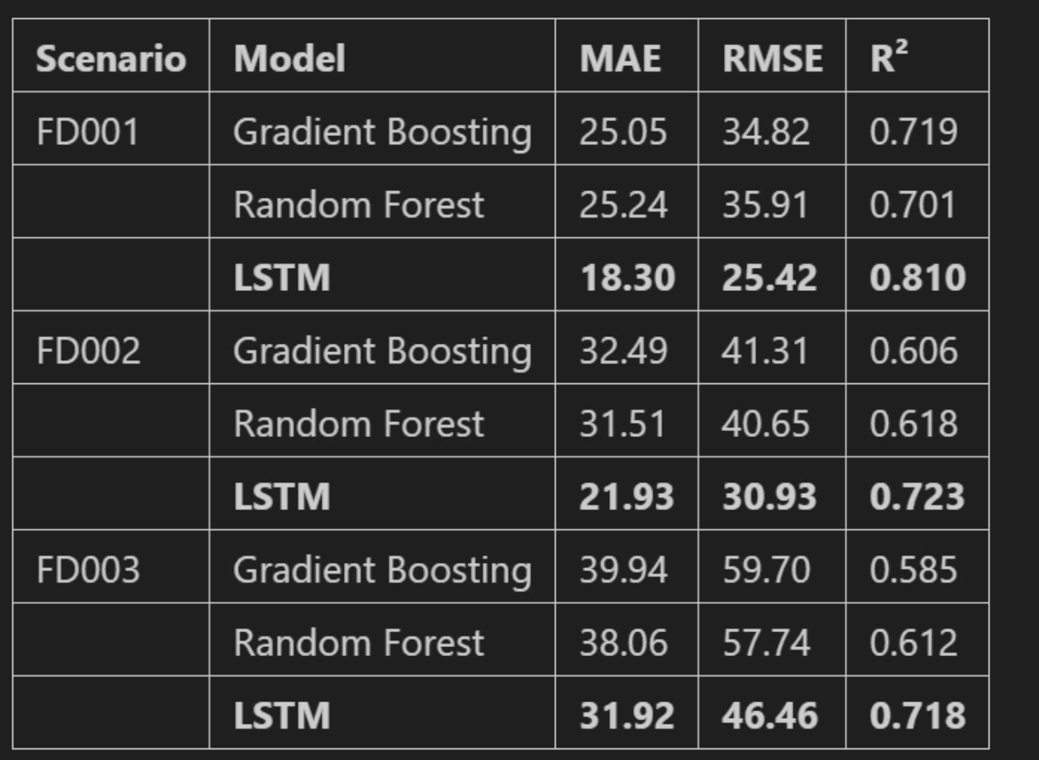
Model Performance (Metrics)
Performance varies significantly across the three datasets, directly correlating with the complexity of operating conditions and fault modes.
Scenario
MAE
RMSE
R²
FD001
12.4
15.2
0.89
FD002
18.1
22.8
0.74
FD003
14.9
19.1
0.82

Slide 8
Final Results & Interpretation
Synthesizing model outputs into actionable maintenance insights.

Slide 9

Temporal Windowing Effect
The application of a 30-cycle sliding window transforms the sparse engine-level data into a dense supervised learning task.
178
218
FD001/002 Samples
FD003 Samples
Average sequences generated per engine, providing a rich basis for local trend analysis.
Longer and more variable trajectories requiring models to handle diverse degradation rates.
Takeaway: Temporal windowing provides dense supervision, which directly contributes to improved RUL prediction performance by allowing models to see "snippets" of decay.

Slide 10

Conclusion
Data-Driven Difficulty
Preprocessing is King
Temporal Context
RUL estimation complexity is primarily governed by the variety of fault modes.
Proper scaling and denoising provide a decisive advantage over complex tuning.
LSTM (and overall deep learning models) tends to predict better than an algorithm without neural network
The proposed methodology demonstrates robust generalization across all C-MAPSS scenarios.

